Slide 1
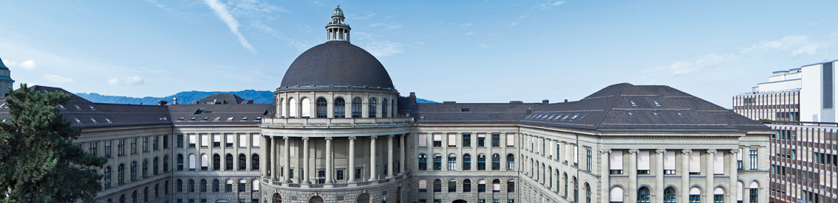
Traffic sign recognition – CNN on microcontrollers
Machine Learning on Microcontroller Course – 2020 ETH Zuerich

Slide 2
Overview
Dataset introduction, challenges
Model selection
Metrics evaluation
Power evaluation
Demo

Slide 3
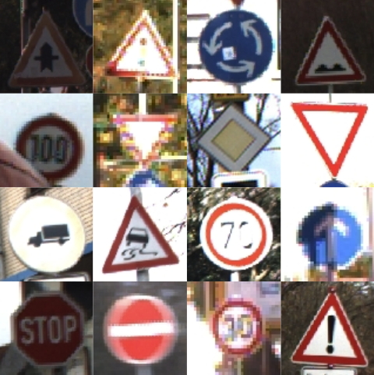
The dataset
The dataset chosen is the German Traffic Sign Recognition Benchmark (GTSRB)
Released for a CV competition in 2011, teams used both handcrafted features and neural network (latter used as benchmark) [1]
Some remarks:
The images contain one traffic sign each
Image sizes vary between 15x15 to 250x250 pixels
Images are not necessarily squared
The actual traffic sign is not necessarily centered within the image.
Sample images

Slide 4
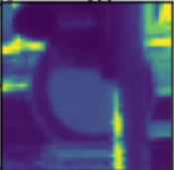
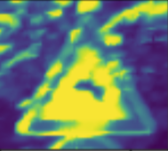
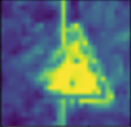
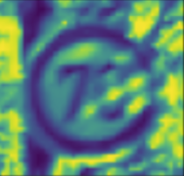
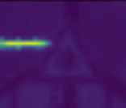
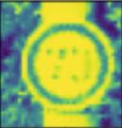
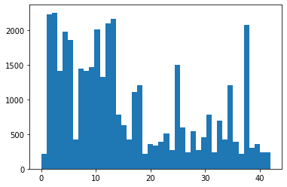
Challenges and class imbalance
Challenges in traffic sign recognition (to name a few):
viewpoint variations
lighting conditions
motion-blur
sun glare
physical damage
43 classes lead to pretty big networks, representing a challenging implementation on uC
Dataset was very umbalanced, with classes in the order 1:10.

Slide 5
How class imbalance was handled
Possible augmentation strategies:
Affine tranform
-> Translation, rotation, scaling and shear somehow already present in the dataset (photos are taken from video of a running car)
Random cutting the images
-> Might cut important part of a signal (as first digit in speed limits)
Photometric distortions
-> Probably the best solution for traffic signs due to variable time of day and weather conditions. Endorsed by GoogLeNet [2][3]
-> Chosen gamma correction to target exposure differences aforhead mentioned [4]

Slide 6
Overview
Dataset introduction, challenges
Model selection
Metrics evaluation
Power evaluation
Demo

Slide 7
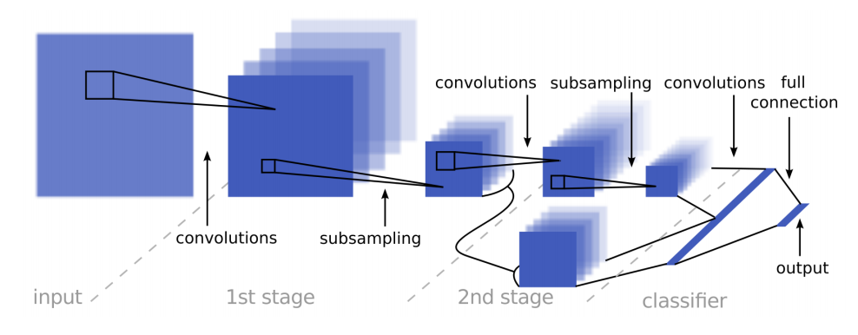
Starting from paper SOA model…
SOA Neural Net model from the GTSRB competition: SermaNet [5]
Pro:
Extremely high accuracy, almost perfect score (98.97%) over a test set of 12600 traffic signs
Cons:
Way too much ROM/RAM (8MB/400kB) needed for a microcontroller implementation
Inference time would be very slow.

Slide 8
… creating a new model, trade off memory and accuracy
How to find a smaller model?
Things done:
Resized the images, from 48*48 to 32*32 (size empirically found as sweet spot)
Grayscaled the images
Reduced number of convolutional filters and dense neurons
->… But how could I find the best?

Slide 9
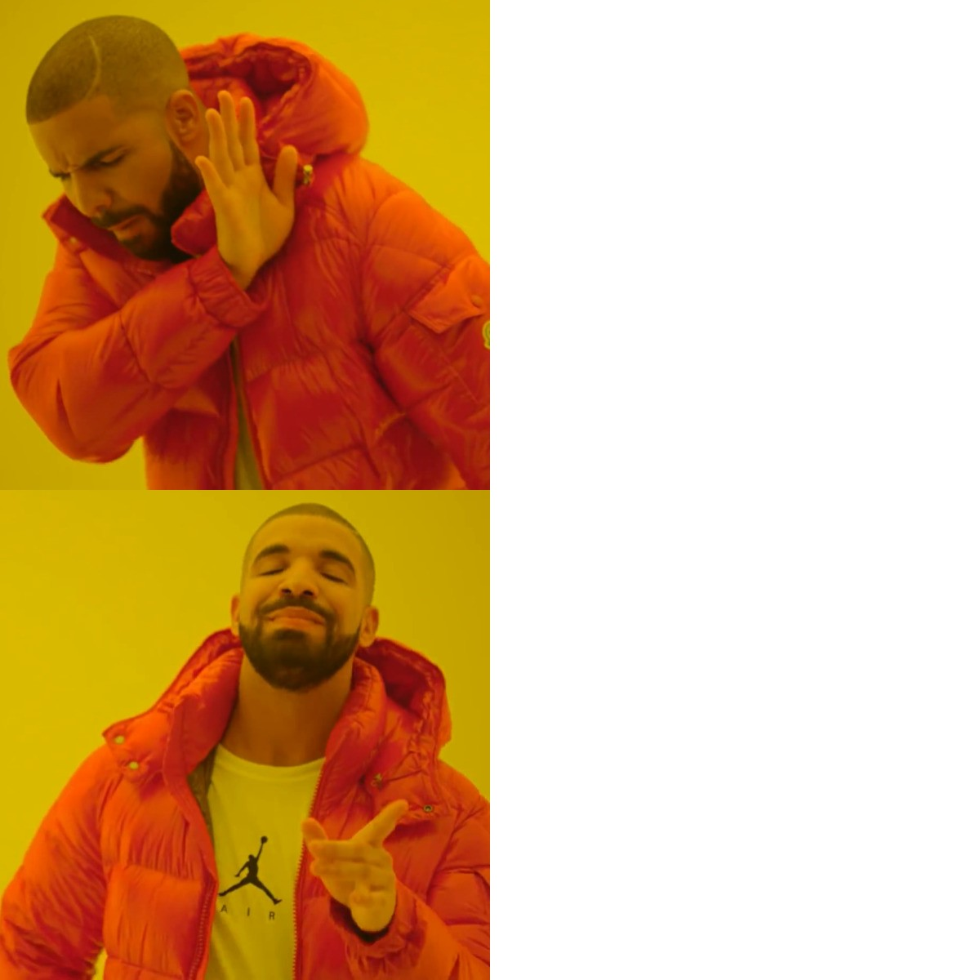


I trained more than 1000 models!
About 1 month
Insert meme drake here
About 2 days

Slide 10
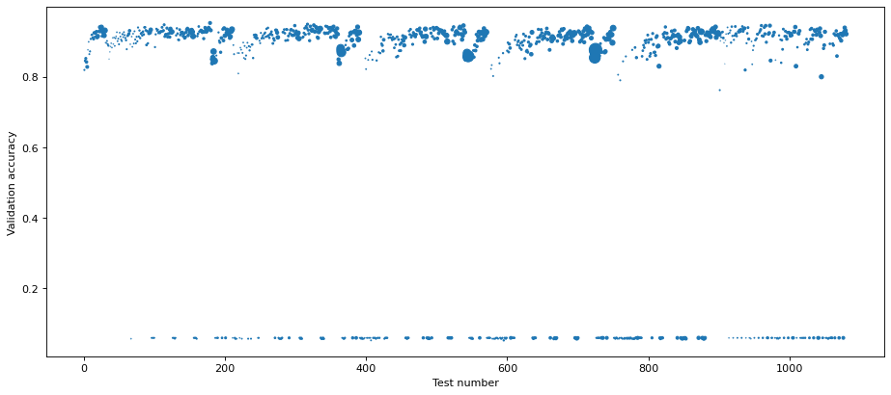
Parameters taken into consideration
I searched over the best among:
Number of layers and filters of convolutional
Number of neurons of the dense.
->They shown the biggest impact on memory and performance
Radius of the ball is the ROM occupancy, computed with a simple mathematical model of the neural net at validation time

Slide 11
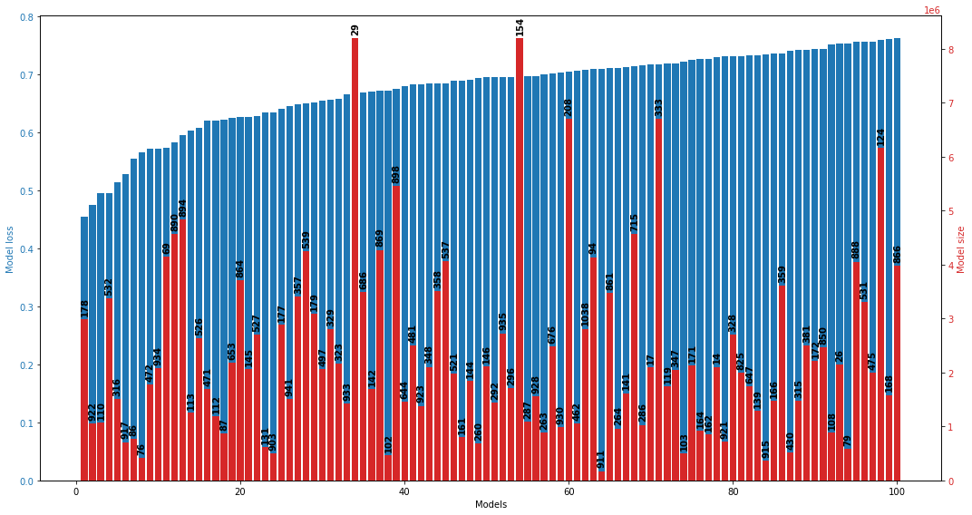
Best 100 models for validation loss
Picked the model with the lower validation loss that could fit on the microcontroller
[Byte]
Used early stopping
to find the right number of epoch and not overfit the models

Slide 12
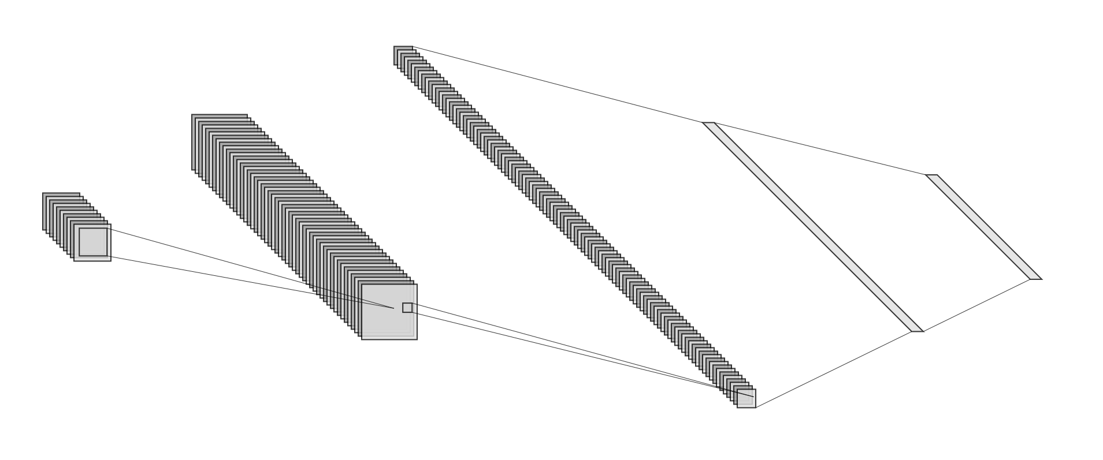
Model selected - GiordyNet
100xConv
2*2
50xConv
100xDense
10*10
43xDense
10xConv
26*26
Input:
32*32
Validation accuracy
Softmax
MaxPooling (2x2),
BatchNorm,
ReLU
ReLU
MaxPooling (2x2),
BatchNorm,
ReLU
MaxPooling (2x2),
BatchNorm,
ReLU
Model number

Slide 13
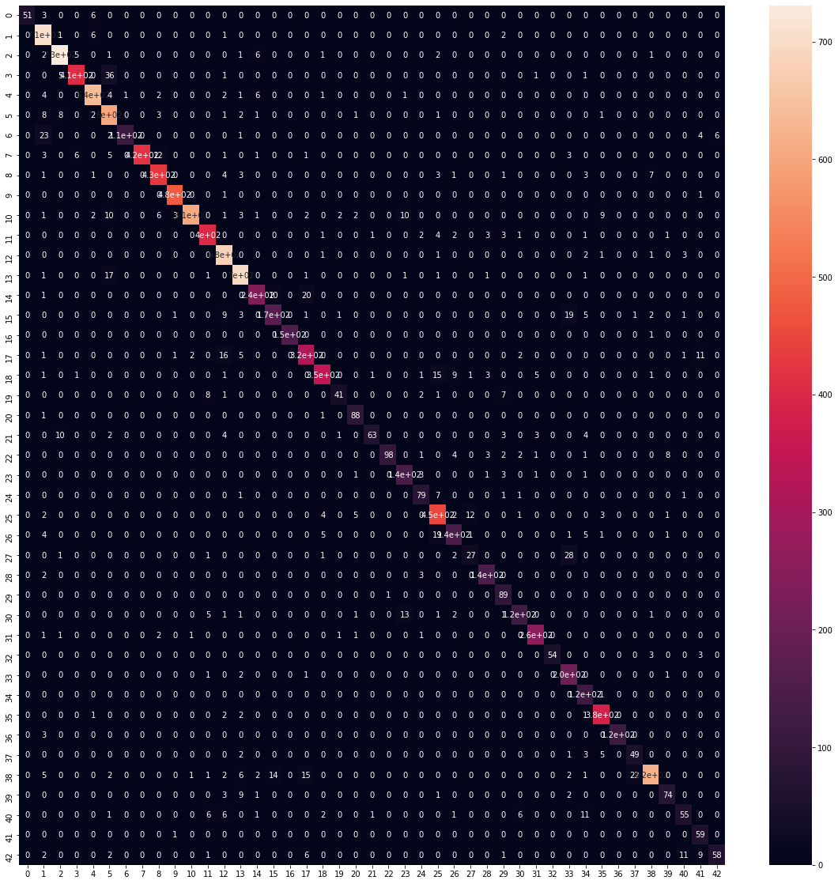

Confusion matrix – SermaNet vs GiordyNet
Accuracy on testset: 98.97 Accuracy on testset: 94.7
ROM/RAM: 8MB/400kB ROM/RAM: 410kB/12kB
MAC: 249,275,645 MAC: 1,496,845
0.04x
19.5x/36.36x
166.5x

Slide 14
Overview
Dataset introduction, challenges
Model selection
Metrics evaluation
Power evaluation
Demo

Slide 15


Frameworks used – Comparison ahead
Not batch normalized
Batch normalized
Non compressed
x4 compression
x8 compression
Quantization aware
16bit floating point
Weights and activation quantized 8bit
Post-training quantization
16bit floating point
Weights quantized 8bit
Weights and activation functions quantized 8bit, fixed point
CubeAI
Backend
NNoM
NNoM
Backend
8bit quantization, fixed point
With CMSIS-NN backend
W/o CMSIS-NN backend

Slide 16
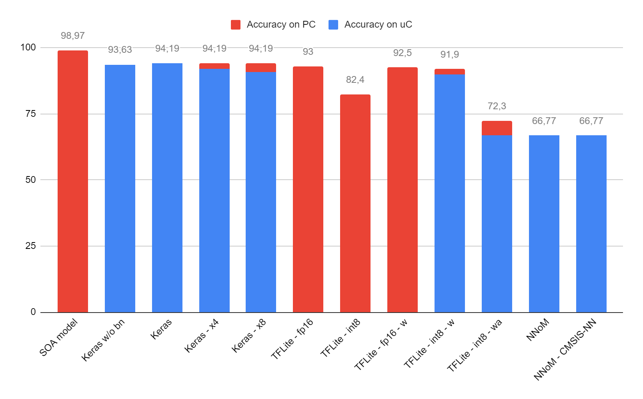
Accuracy
Remarks:
all models has been tested on PC
Quantization aware is not supported in CubeAI yet, as 16bit floating point, so I tested only on PC
In GCC FP16 are store variable only, so has to be casted to FP32 for computation
-w suffix means only weights are quantized, -wa means both weights and activation functions
Percentage
Quant aware
Post-training quant

Slide 17
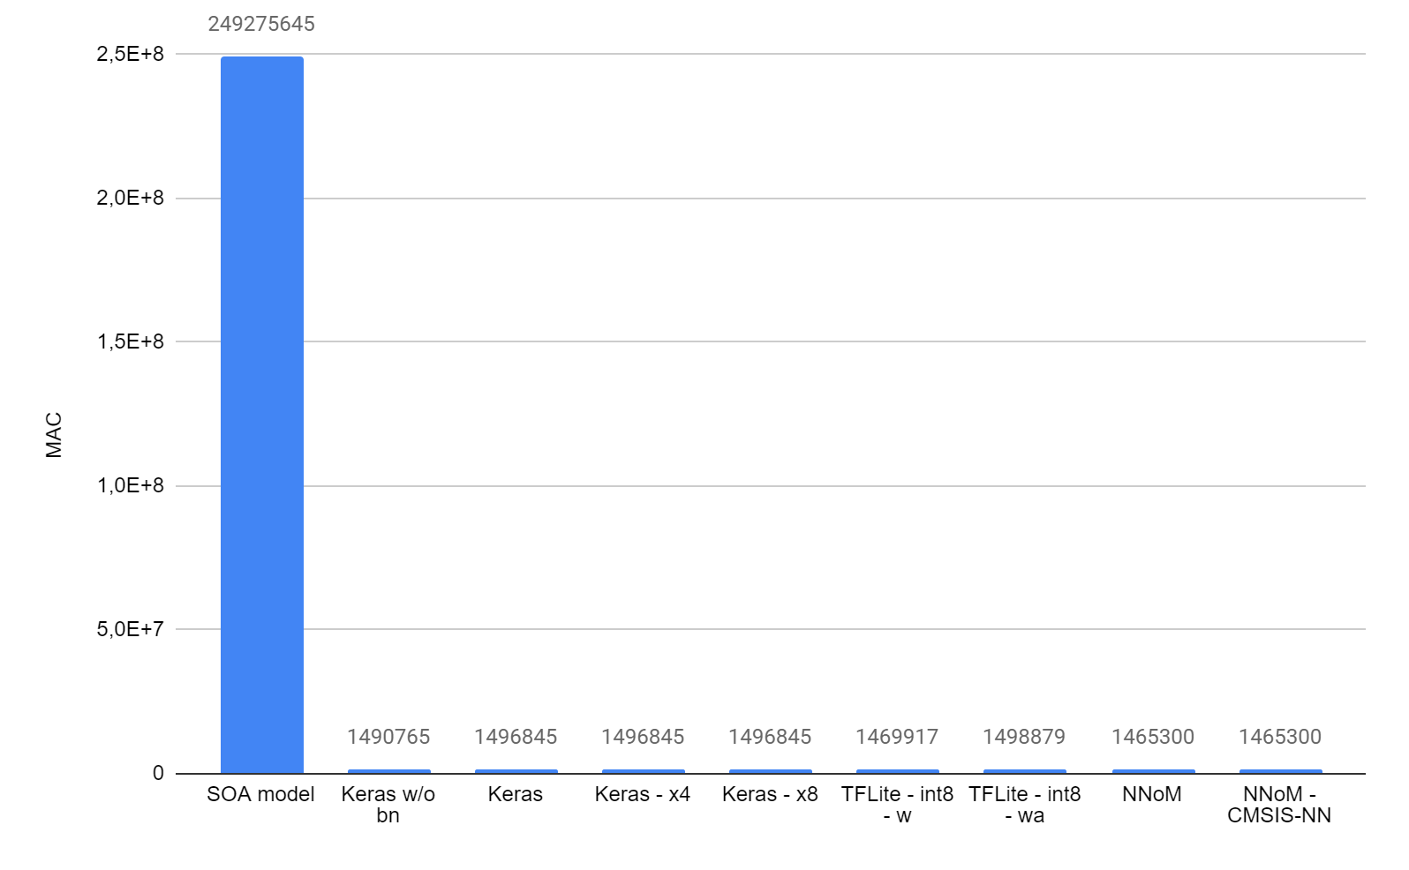
Speed performance – MAC Operations, comparison with SOA

Slide 18
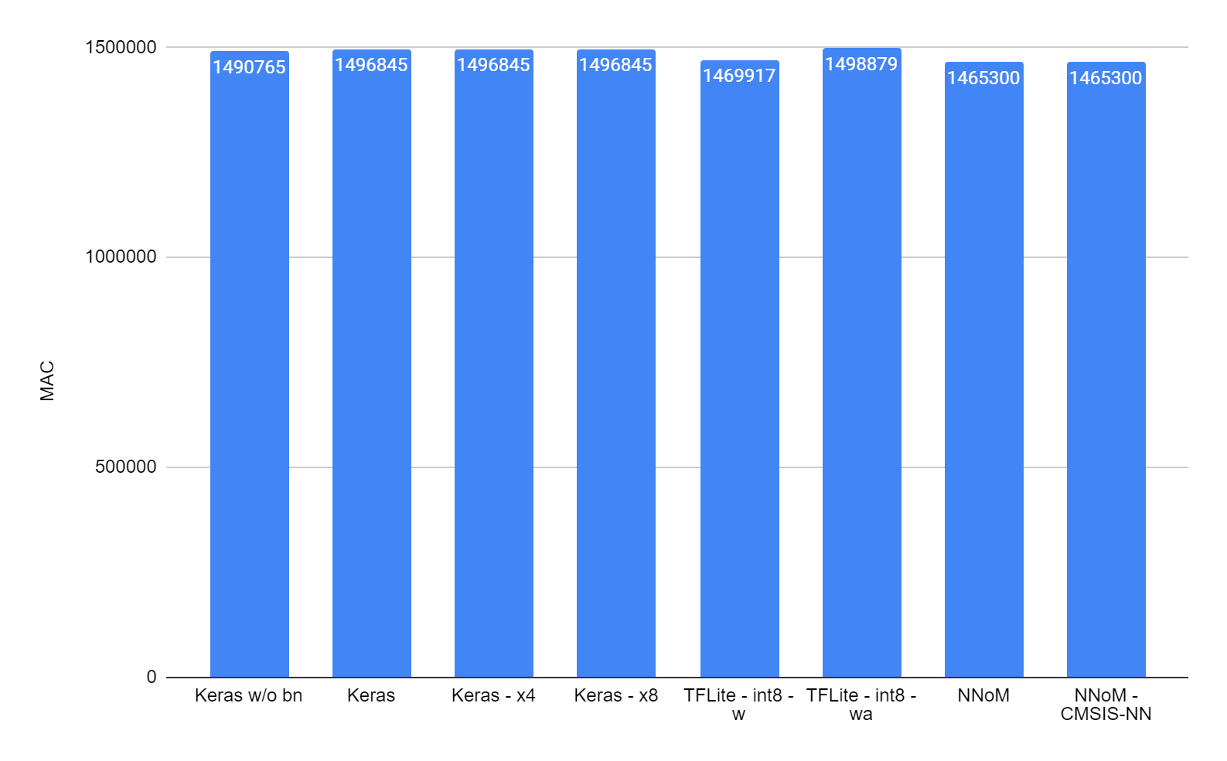
Speed performance – MAC Operations

Slide 19
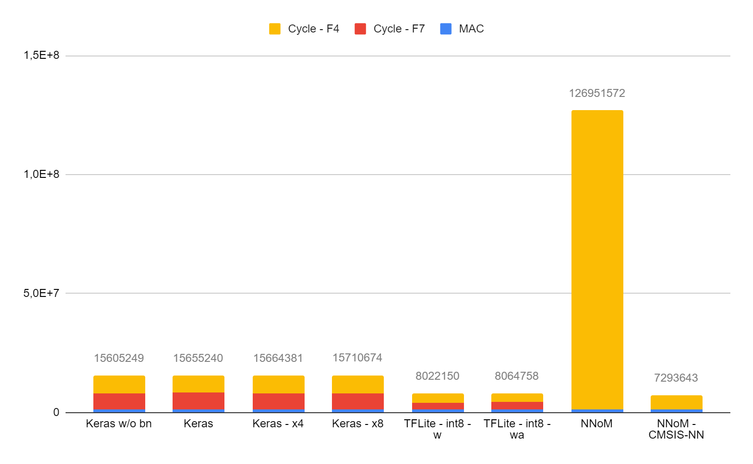
Speed performance – MAC Operations
I also tried with different compiler optimizations settings, and the only notable difference was with NNoM without the CMSIS-NN backend:
CMSIS-backed implementation with o-fast option between 1e-3 and 1e-4 relative difference than o-none
“Pure math” implementation with o-fast option: about 5.5x less cycles required than o-none
Please also note that in every test the hardware floating point implementation was activated:
-mfloat-abi=hard

Slide 20
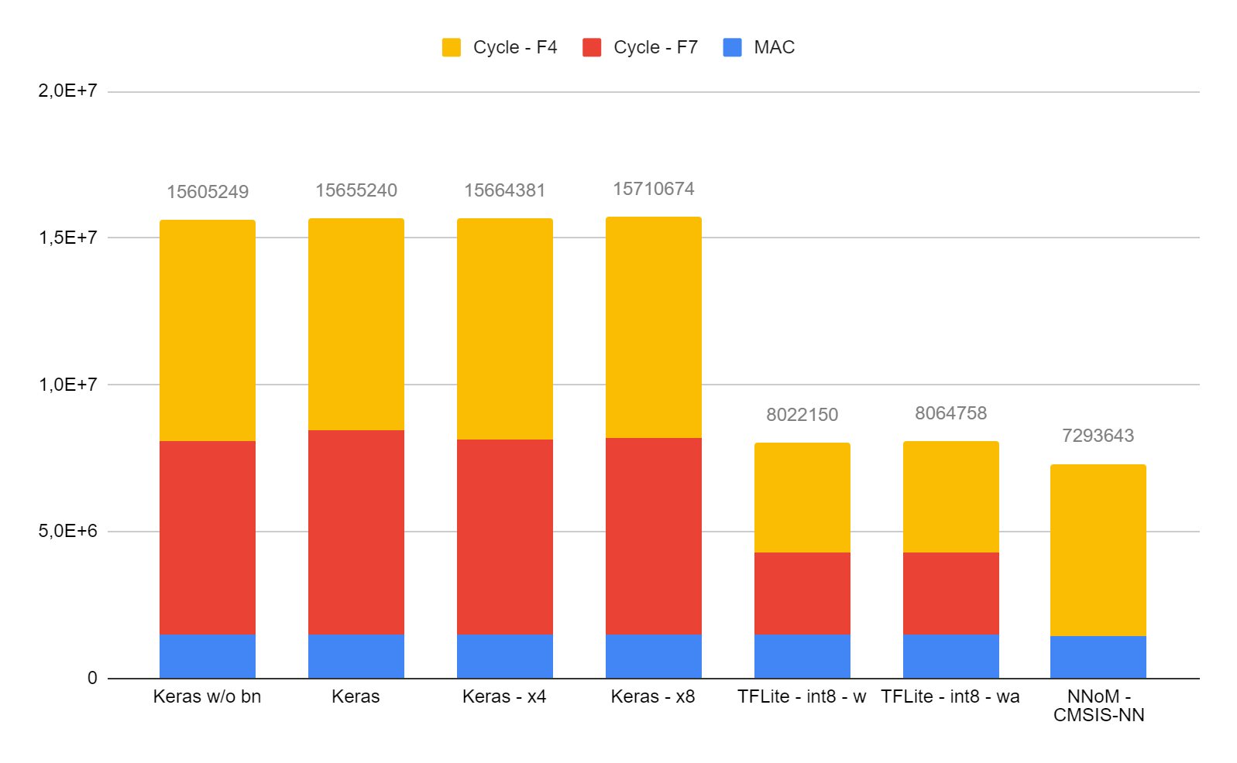
Speed performance – Cycles (and MAC)
Average cycle/MAC_op:
 | STM32F7 | STM32F4
FP32 Op | 6 | 10.4
Int8 Op | 0.23 | 0.26
My bet: SIMD instructions

Slide 21
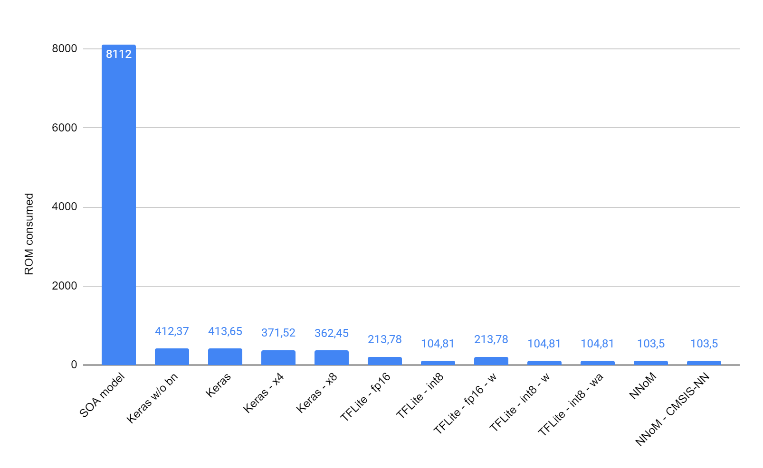
Memory usage – ROM, comparison with SOA
kBytes

Slide 22
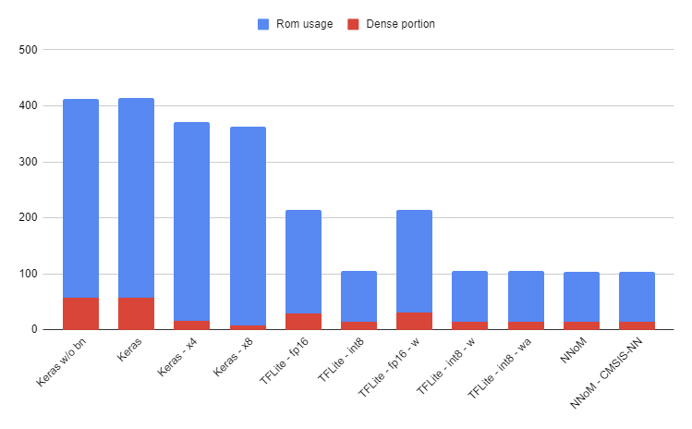
Memory usage – ROM
We can observe how CubeAI compression affects only dense layers
The biggest model is less than half of the ROM available on STM32L4, and the smallest one is near 10% of memory occupation
kBytes

Slide 23
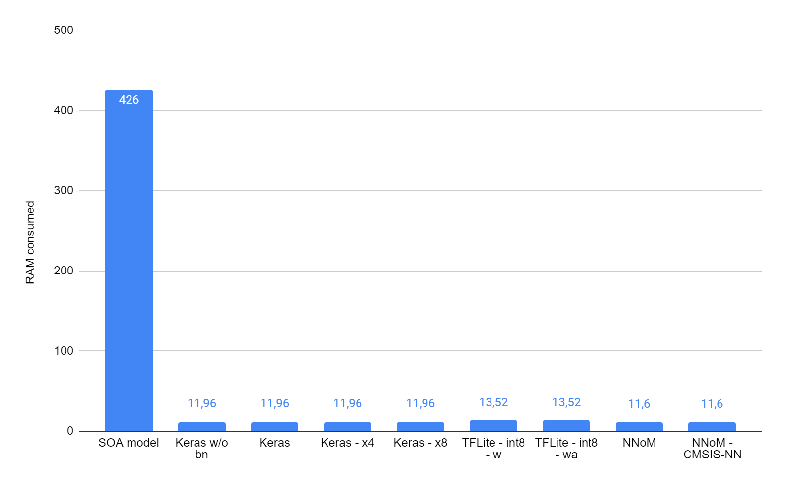
Memory usage – RAM, comparison with SOA
[kBytes]

Slide 24
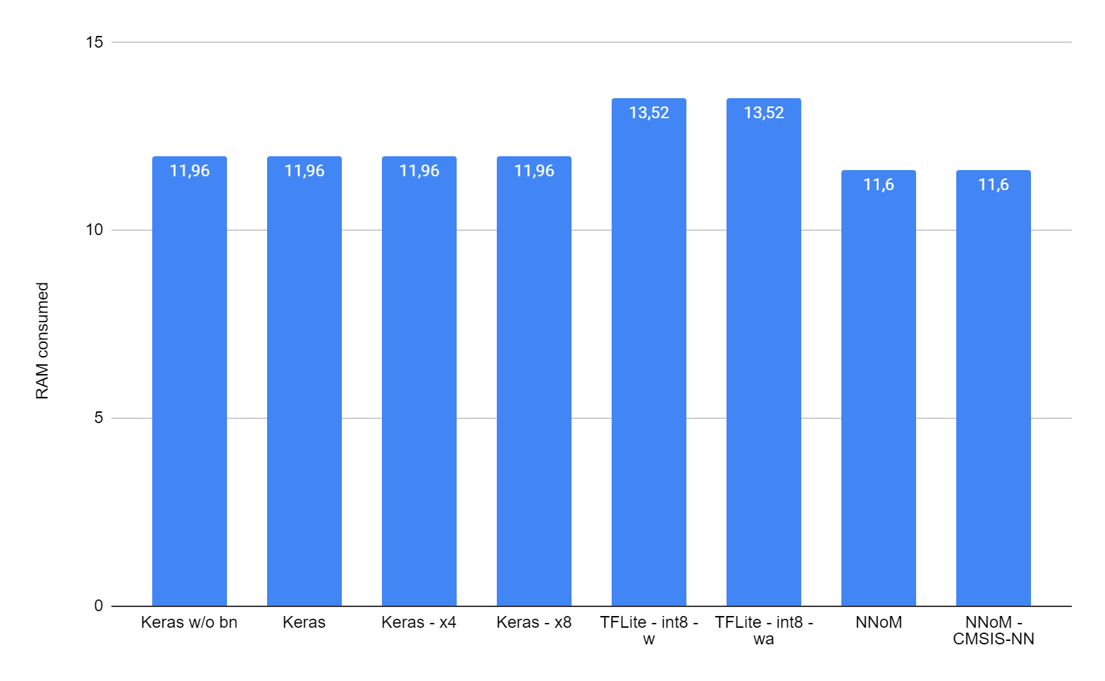
Memory usage – RAM
[kBytes]
Ram usage is rather good,
it uses around 10% of RAM available on STM32L4

Slide 25
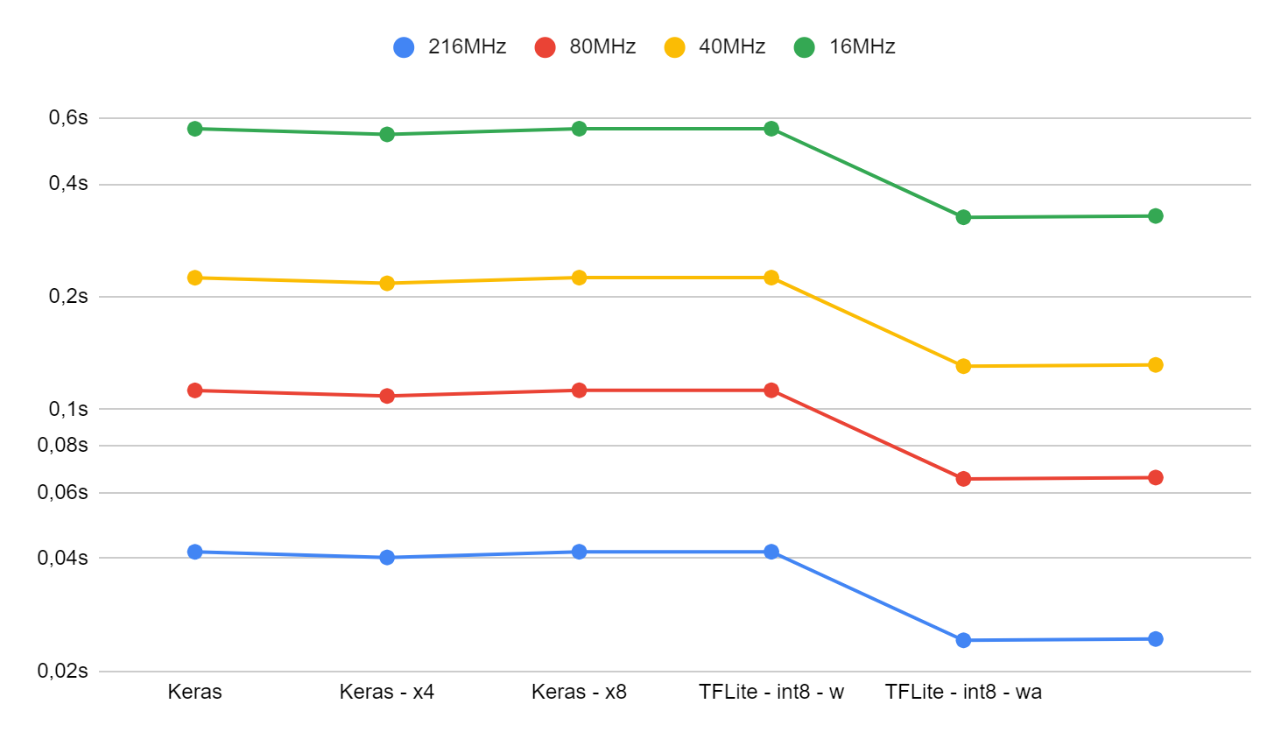
Inference time – F7

Slide 26
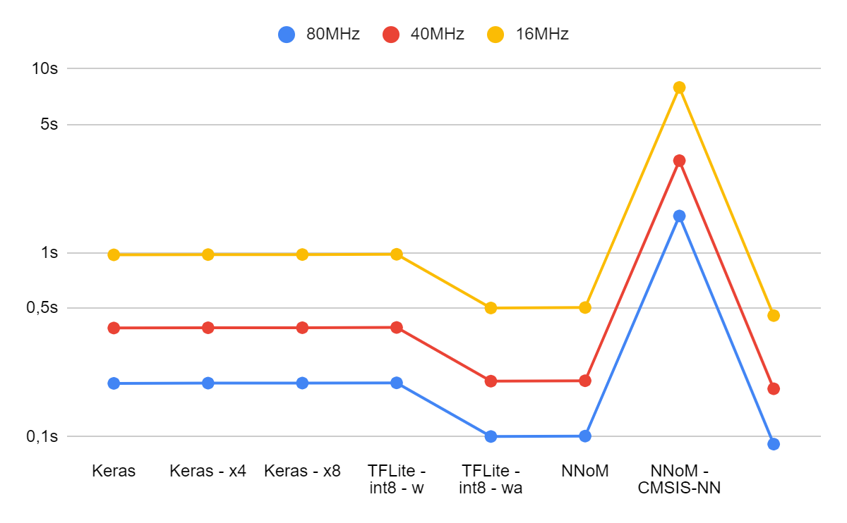
Inference time – F4
CMSIS-NN

Slide 27
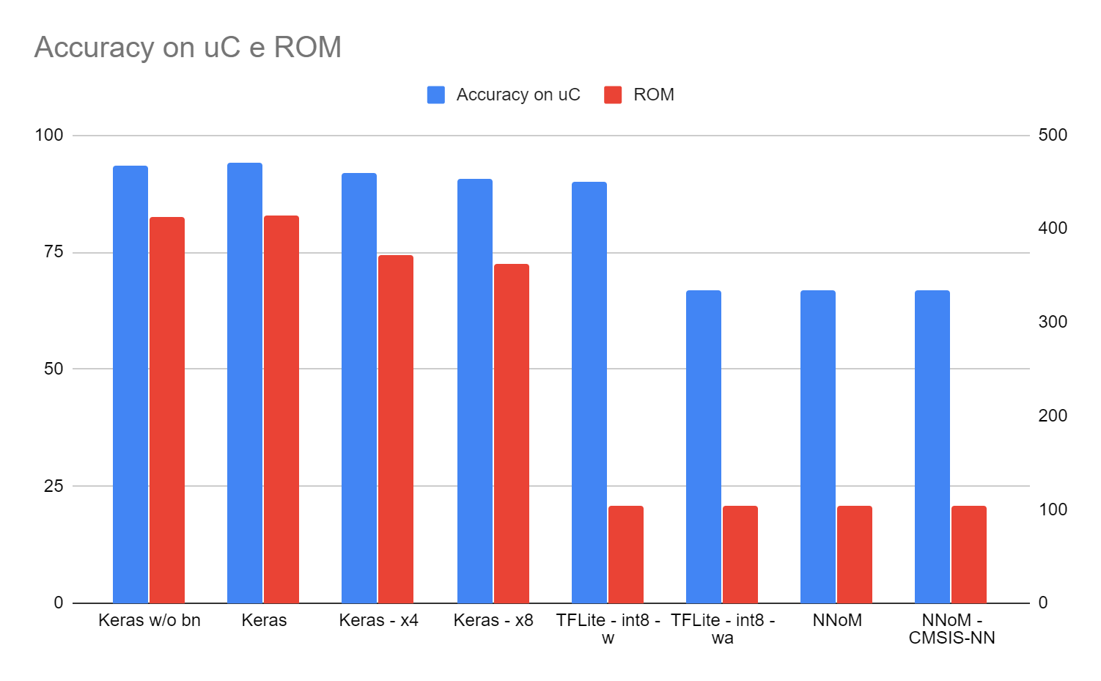
Summary – Precision/ROM
Best tradeoff model highlighted in yellow
[kBytes]
Percentage
CMSIS-NN

Slide 28
Summary table of all metrics – Highlighted the best model
Quant/Not quant | Implementation | Test | Backend | Accuracy PC [%] | Accuracy uC [%] | MAC | Cycle | Time for inference | ROM [kB] | RAM [kB]
Non quant | PC | SOA model | Keras | 98,97 | - | 249275645 | - | - | 8112 | 426
Non quant | PC/uC-CubeAI | Keras w/o bn | Keras | 93,63 | 93,63 | 1490765 | 15605249 | 195,0656125 | 412,37 | 11,96
Non quant | PC/uC-CubeAI | Keras | Keras | 94,19 | 94,19 | 1496845 | 15655240 | 195,6905 | 413,65 | 11,96
Non quant | PC/uC-CubeAI | Keras – compress x4 | Keras | 94,19 | 91,89 | 1496845 | 15664381 | 195,8047625 | 371,52 | 11,96
Non quant | PC/uC-CubeAI | Keras – compress x8 | Keras | 94,19 | 90,79 | 1496845 | 15710674 | 196,383425 | 362,45 | 11,96
Quant aware | PC | TFLite - fp16 | TFLite | 93 | - | - | - | - | 213,78 | -
Quant aware | PC | TFLite - int8 | TFLite | 82,4 | - | - | - | - | 104,81 | -
Post train quant | PC | TFLite - fp16 - w | TFLite | 92,5 | - | - | - | - | 213,78 | -
Post train quant | PC/uC-CubeAI(demo) | TFLite - int8 - w | TFLite | 91,9 | 90,71 | 1469917 | 8022150 | 100,276875 | 104,81 | 13,52
Post train quant | PC/uC-CubeAI | TFLite - int8 - wa | TFLite | 72,3 | 66,87 | 1498879 | 8064758 | 100,809475 | 104,81 | 13,52
Post train quant | PC/uC-NNoM | NNoM | Keras - NNoM | 66,77 | 66,77 | 1465300 | 126951572 | 1586,89465 | 103,5 | 11,6
Post train quant | PC/uC-NNoM (demo) | NNoM - CMSIS-NN | Keras - NNoM | 66,77 | 66,77 | 1465300 | 7293643 | 91,1705375 | 103,5 | 11,6

Slide 29
Overview
Dataset introduction, challenges
Model selection
Metrics evaluation
Power evaluation
Demo

Slide 30
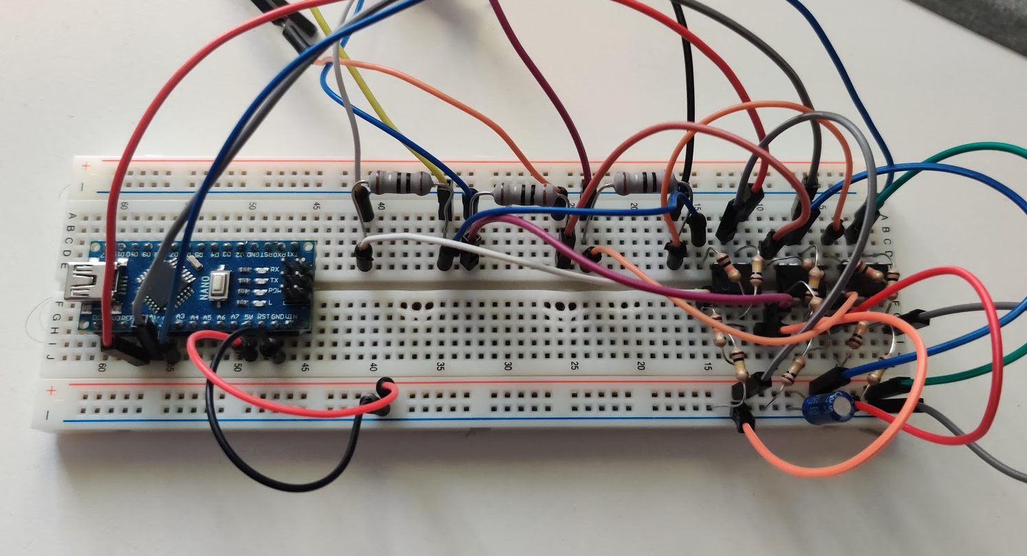
Testbench
Unfortunately I do not have a power meter at home, so I built one!
It is a shunt ammeter featuring an Arduino and an instrumental amplifier made with three UA741

Slide 31
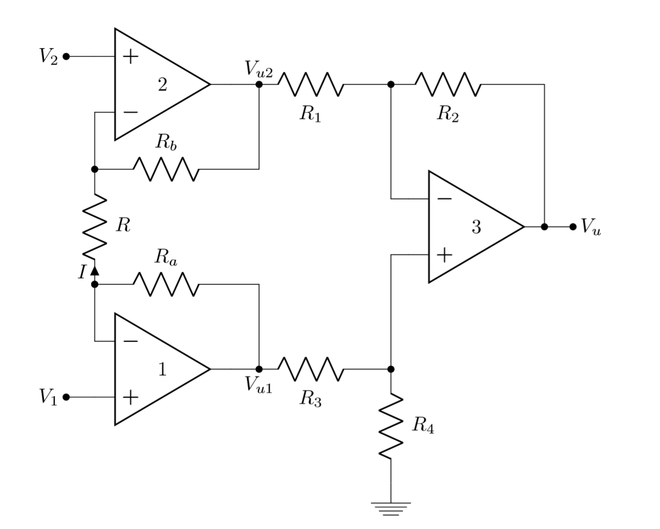
Testbench
Using three opamps to decouple impedences from the shunt resistor and amplyfing so I could put a low resistor (1.8ohm) and have a low burden voltage (less than 0.2V)

Slide 32
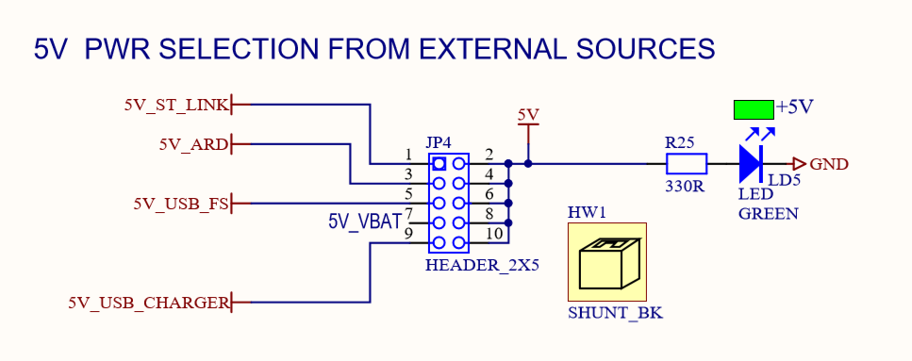
Testbench
After researching on the schematic provided by ST for the Nucleo board I could only spot the header that powers the entire board, sensors included.
To not poison the results I have measured the current consumption of the board putting the uC in sleep mode and so offsetting the further readings
Credits: ST Electronics

Slide 33
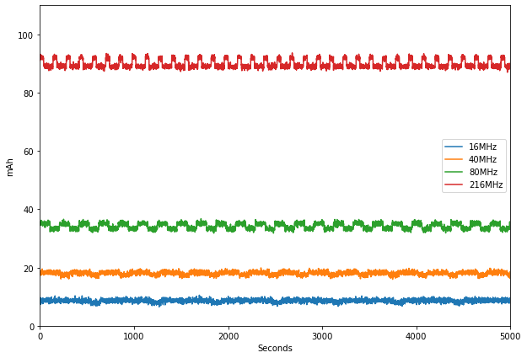
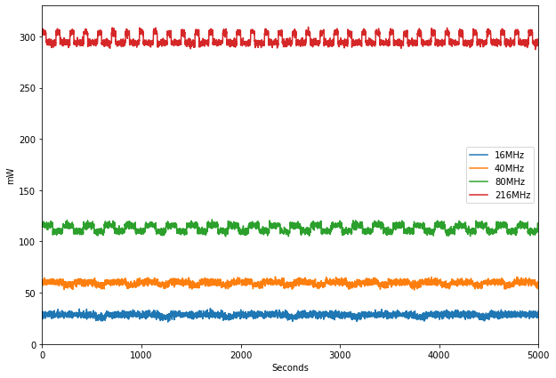
Testbench

Slide 34
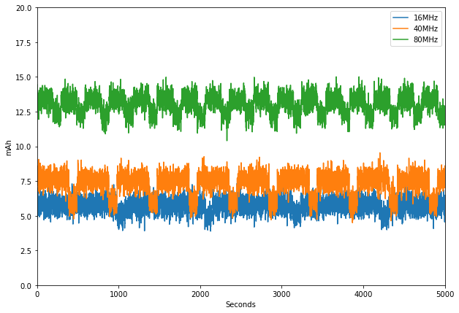
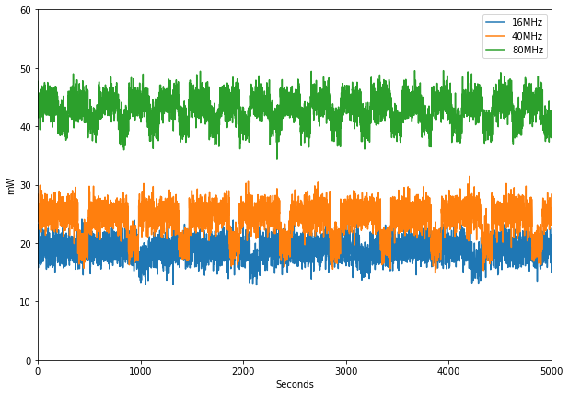
Testbench

Slide 35
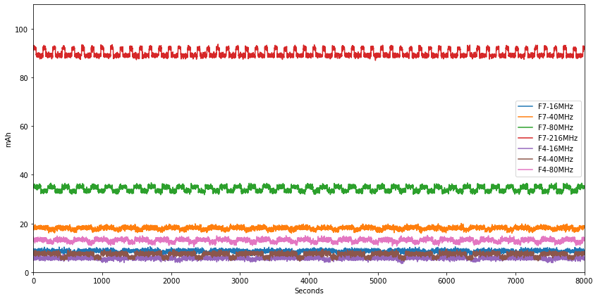
Testbench

Slide 36
Summary on power consumption – Tensorflow int8-w
Freq | Current-F4 | Current-F7 | Power-F4 | Power-F7 | Energy/inference F4 | Energy/inference F7
216MHz | - | 90mA | - | 300mW | - | 12mJ
80MHz | 12.5mA | 38mA | 46mW | 117mW | 8.6mJ | 13mJ
40MHz | 7.5mA | 20mA | 27mW | 58mW | 10.5mJ | 13mJ
16MHz | 5.5mA | 10mA | 18mW | 39mW | 17.55mJ | 9.9mJ

Slide 37
Overview
Dataset introduction, challenges
Model selection
Metrics evaluation
Power evaluation
Demo

Slide 38
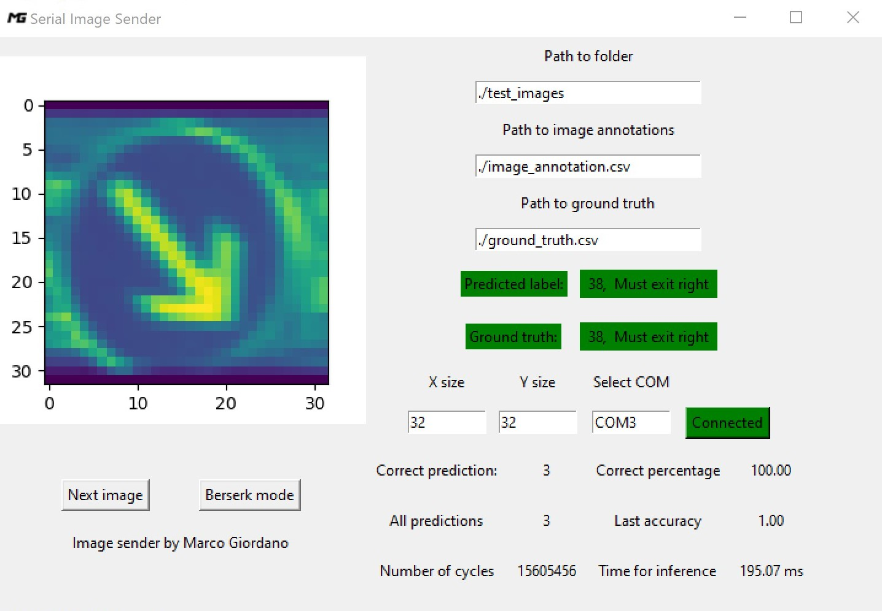
Demo!
Actually it has been running for the whole presentation ;)
Tensorflow lite (post train quant) with 8-bit weight quantization on STM32F723
NNoM with CMSIS-NN backend on STM32L475
GUI to automate the process
Real time power figures with APM! (Arduino Power Monitor :)

Slide 39
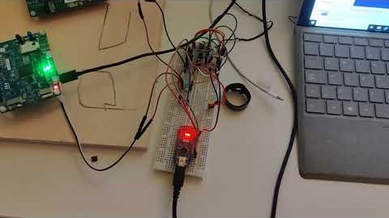
Video Demo

Slide 40
References
[1] https://www.ini.rub.de/upload/file/1470692848_f03494010c16c36bab9e/StallkampEtAl_GTSRB_IJCNN2011.pdf
[2] https://arxiv.org/pdf/1409.4842.pdf
[3] https://arxiv.org/ftp/arxiv/papers/1312/1312.5402.pdf
[4] https://docs.opencv.org/3.4/d3/dc1/tutorial_basic_linear_transform.html
[5] http://yann.lecun.com/exdb/publis/pdf/sermanet-ijcnn-11.pdf
[6] https://gcc.gnu.org/onlinedocs/gcc/Half-Precision.html

Slide 41
Presentation is finished!
Thank you for you attention!

